Slide 1
Introduction to Crypto
1
Cryptos as an Assets Class & Blockchain Innovation
Kathryn Zhao
Denis Imaev

Slide 2
Introduction to Crypto
Cryptos are a story
Why and when
Reasons, tries and trials. Future is unknown.
What and how
Technology is ready: math, computer science
Fast, accessible (and cheap) global networks, wired and wireless
“Mechanical sympathy”
If you know how a car works, you make a better driver

Slide 3
Introduction to Crypto
Why are cryptos (digital assets) – assets?
What is their value?
What determines their price?
If the value is in “blockchain,” what is the value of “blockchain”?
Why “blockchain”?

Slide 4
Introduction to Crypto
Whatever the value of cryptos is…
“US Bitcoin ETFs Continue Inflow Streak, Funds Now Hold 4.47% of BTC’s Market Cap”
(as of mid July 2024)
https://news.bitcoin.com/us-bitcoin-etfs-continue-inflow-streak-funds-now-hold-4-47-of-btcs-market-cap
“Institutional Interest Drives Digital Asset Growth in Early 2024, Says Report”
https://news.bitcoin.com/digital-assets-thrive-in-h1-2024-cme-and-glassnode-report-finds
... Clearly, people place some value now!

Slide 5
Introduction to Crypto
5
… What is it blockchain and cryptos?

Slide 6
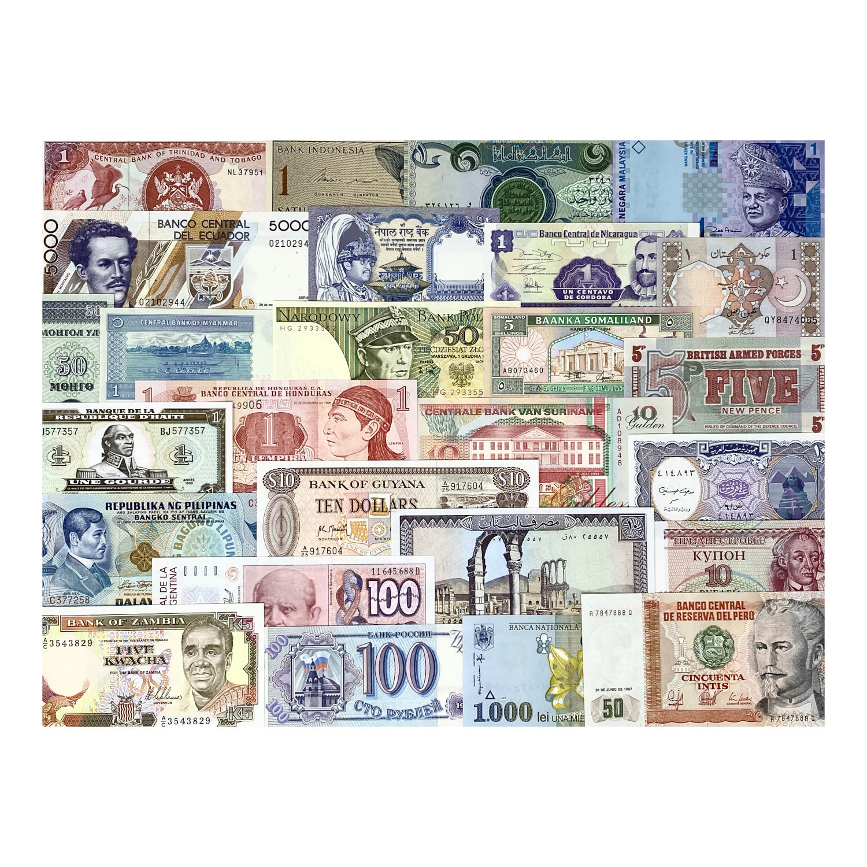
Introduction to Crypto
Money?
…. But what is money?
“Private money”

Slide 7
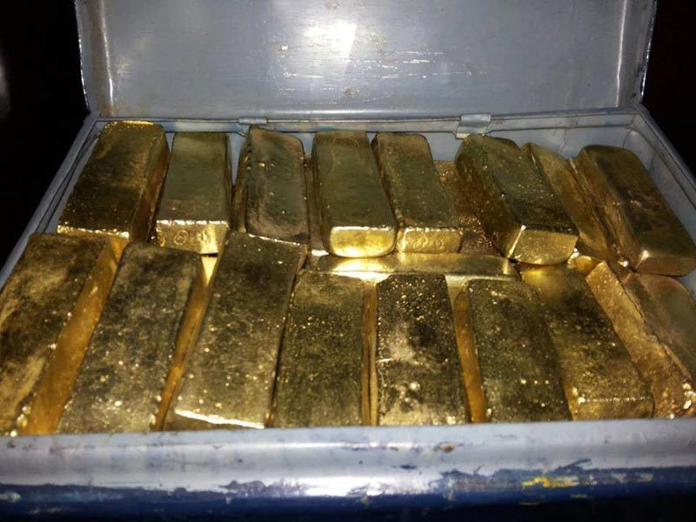
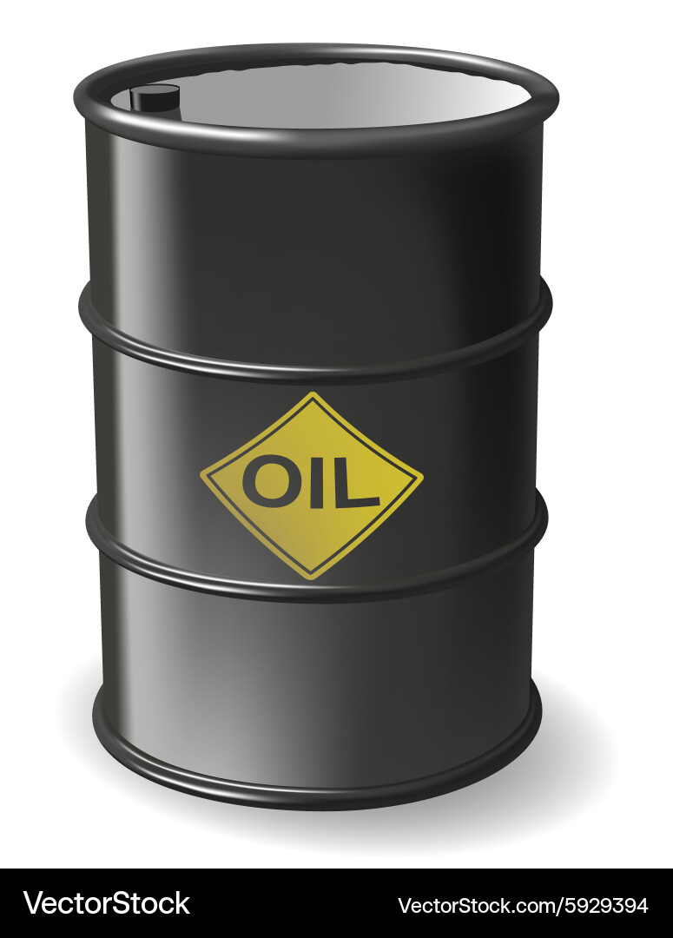
Introduction to Crypto
Commodity?
Something that has an
Intrinsic value or Utility ?

Slide 8
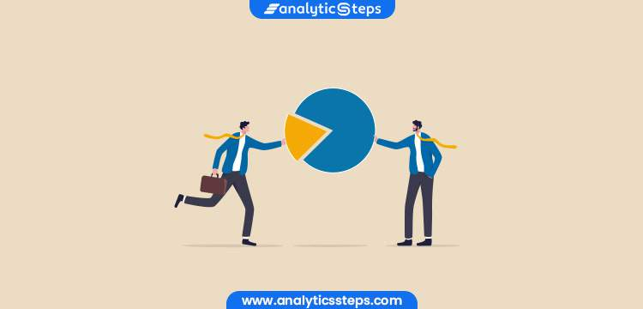
Introduction to Crypto
Equity, a stake in some corporation?
Share of profit

Slide 9
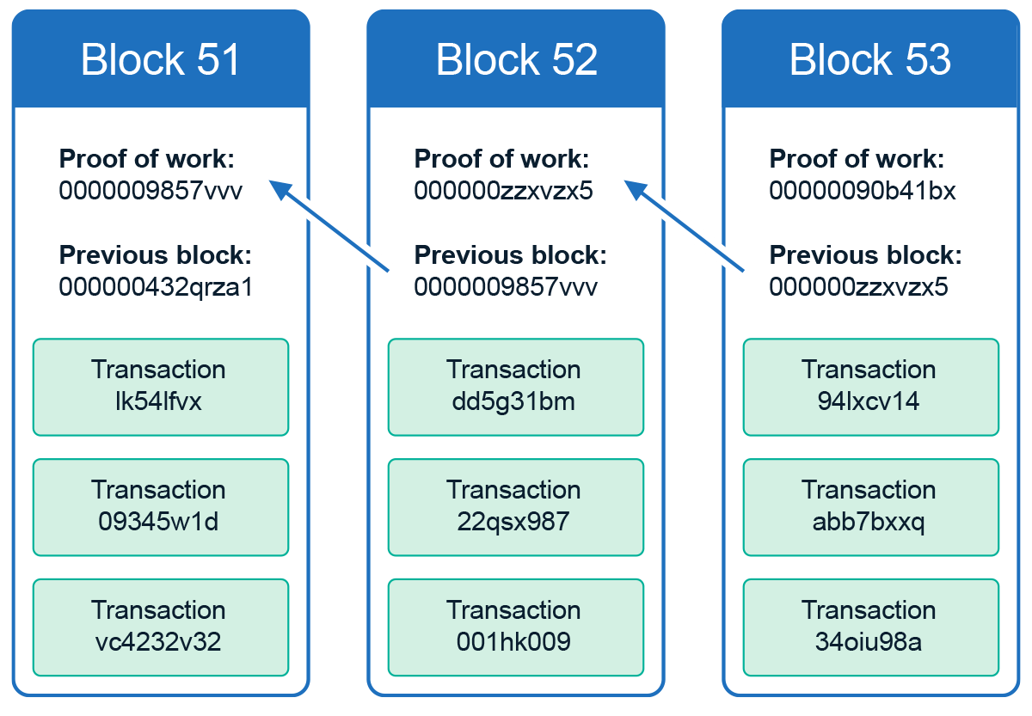
Introduction to Crypto
Blockchain
Way to arrange bits of data such that they depend on each other, and this dependence is based on their content and temporal order.
Bits of data: “transactions”.
Transactions are batched into blocks. Each subsequent block contains a “fingerprint” (hash) of the previous block, so they are linked into a linear sequence.
Sequence of transactions.

Slide 10
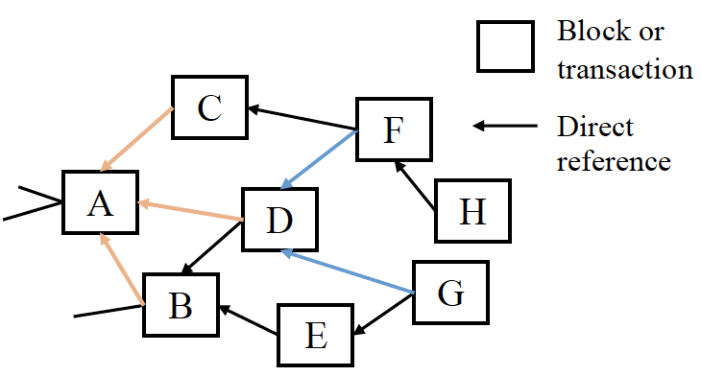
Introduction to Crypto
Graph
DAG: tree (web) of transactions
Transactions can be evaluated simultaneously: potentially faster processing
No block generation time (mining)
Tree allows for more complex interconnections between TX
Blockchain, DAG: a transaction ledger!

Slide 11
Introduction to Crypto
Fun tech behind blockchains
Math: operations magic
Cryptography: operations that are easy to compute but very (very!) hard to reverse
Computer science: data magic
Data representation: can check validity without knowing data itself. Like a “signature”.

Slide 12

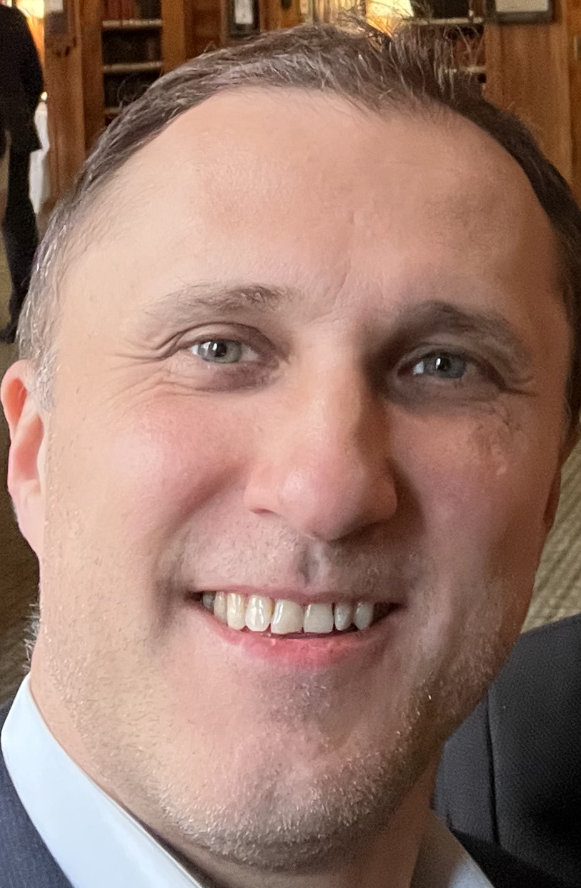
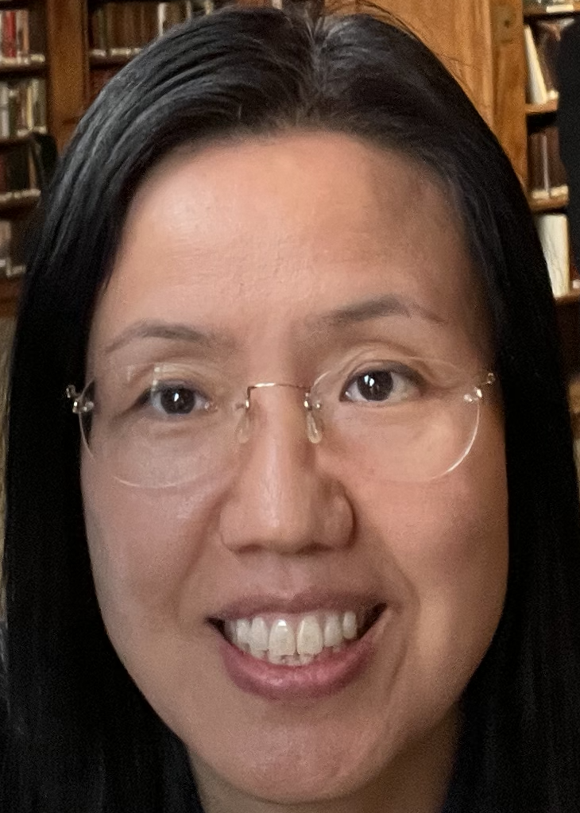
Introduction to Crypto
Distributed Ledger
shared by multiple independent actors: everyone has the same copy
Having everyone agreeing on transactions and their sequences is called reaching a consensus.
Tx1
Tx2
Tx3
Tx1
Tx2
Tx3
Tx1
Tx2
Tx3
Tx1
Tx2
Tx3

Slide 13
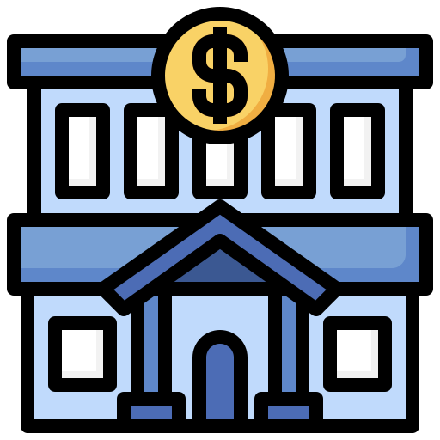
Introduction to Crypto
Consensus – how to reach?
Trust each other: every transaction out there is assumed true
What can go wrong?
Trust 3rd parties: banks, governments, corporations
They resolve disputes too… (arbitrage)
Tx1
Tx2
Tx3
Tx1
Tx2
Tx3

Slide 14
Introduction to Crypto
Trusting 3rd parties means that we must…
pay them for services
rely on their reliability and honesty without knowing much about how they operate and who controls them
cope with their failures: they break too
share our data with them!
Can we stop trusting intermediaries?
Things may become cheaper, more reliable and safer

Slide 15
Introduction to Crypto
Can we come up with a Trust-less Consensus ?
There are few problems that make reaching global consensus a non-trivial problem:
World is parallel, so many things happen at the same time, and they can be conflicting
World is big, so transactions take time to reach everyone.
This also makes (1) more likely to happen.
Miscommunication, malfunction etc.
Malicious actors - a special case of (3)
Designing a trust-less multi-actor system where it is possible to reach a consensus in the presence of malicious (also faulty, malfunctioning etc.) actors is a whole field in engineering and computer science.

Slide 16
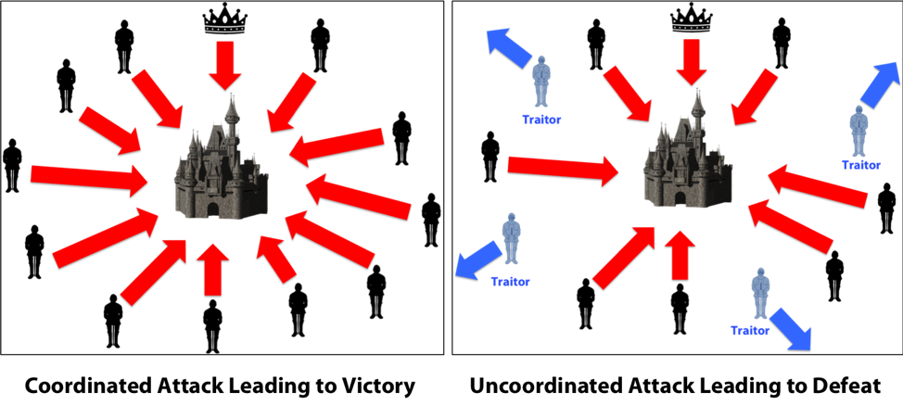
Introduction to Crypto
Byzantine General Problem

Slide 17
Introduction to Crypto
Classic Consensus: a lot of communication!
Consensus protocols have existed for a while now
Building distributed systems is hard: the more actors there are, the more “robust” the system is, but the harder it is to get them to achieve consensus.
“Classic” consensus protocols are expensive, and do not scale well if the system is very large and very distributed: it takes a lot of time to make sure everyone is in agreement,
…. because to agree they need to communicate
The complexity grows exponentially as the network participant numbers grow.

Slide 18
Introduction to Crypto
Nakamoto consensus: Proof-of-work
Global blockchain does not grow by itself: transactions need to be propagated, validated etc. Someone must do it…
But what will they get in return? What is the blockchain builders’ incentive?
The incentive must be for “honest” work.
Key question: what prevents you from creating a “double spend” with two transactions transferring the same money to two different destinations.
Proof-of-Work: distributed consensus protocol where independent network participants perform “work” to build and broadcast blocks and validate transactions, growing the chain and getting rewards for the work done.

Slide 19
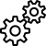
Introduction to Crypto
Account A
Account B
Account C
Account D
Tx 1
Tx 3
Tx 2
Tx 7
Tx 5
Tx 4
Tx 6
network
Block Builder
Block Builder
Block Builder
Tx 2
Tx 3
Tx 4
Tx 6
Fee
Tx 1
Tx 7
Tx 5
Tx 3
Fee
Tx 5
Tx 3
Tx 4
Tx 6
Tx 1
Tx 2
Fee
Calculating…
Calculating…
Calculating…
Block
(Tx, Tx, …)
Block
(Tx, Tx, …)
Next block … ???

Slide 20
Introduction to Crypto
Tx1
Tx7
Tx9
network
Tx4
Tx 2
Tx5
Tx6
Block Builder
Block Builder
Block Builder
Tx 2
Tx 3
Tx 4
Tx 6
Fee
Tx 1
Tx 7
Tx 5
Tx 3
Fee
Tx 5
Tx 3
Tx 4
Tx 6
Tx 1
Tx 2
Fee
SOLUTION FOUND
Calculating…
Calculating…
Block
(Tx, Tx, …)
Block
(Tx, Tx, …)
Block
(Tx 2, Tx 3, Tx 4, Tx 6, Fee)

Slide 21
Introduction to Crypto
Anyone can join the network and help building it for a reward.
The more participants – the merrier! Block can be found faster! Network is stronger!
…. This also means that several participants can find valid blocks at the same time…
… which creates a fork

Slide 22
Introduction to Crypto
Tx1
Tx7
Tx9
network
Tx4
Tx 2
Tx5
Tx6
Block Builder
Block Builder
Block Builder
Tx 1
Tx 7
Tx 5
Tx 3
Fee
Tx 2
Tx 3
Tx 4
Tx 6
Fee
Tx 5
Tx 3
Tx 4
Tx 6
Tx 1
Tx 2
Fee
SOLUTION FOUND
SOLUTION FOUND
Calculating…
Block
(Tx 1, Tx 7, Tx 5, Tx 3, Fee)
Block
(Tx, Tx, …)
Block
(Tx, Tx, …)
Block
(Tx, Tx, …)
Block
(Tx 2, Tx 3, Tx 4, Tx 6, Fee)

Slide 23
Introduction to Crypto
Proof of Work
Only one, the longest chain, is selected as the “true” one at any time
It can be any “branch”, it does not matter which
In time, one of the branches will become longer
… and everyone will switch to it.
double-spend transactions (conflicting) are two conflicting forks
but only one will be ultimately selected!
So the participant pushing two conflicting transactions will have to do twice the work to create two blocks, however only one transaction will be accepted.

Slide 24

Introduction to Crypto
Tx1
Tx7
Tx9
network
Tx4
Tx 2
Tx5
Tx6
Block Builder
BAD TX
Fee
Tx 1
Tx 7
Tx 5
Tx 3
Fee
SOLUTION FOUND
SOLUTION FOUND
Block
(Tx, Tx, …)
Block
(Tx, Tx, …)
Block
(Tx 1, Tx 7, Tx 5, Tx 3, Fee)
Block
(Tx, Tx, …)
STOP No way to make it longer
Block
(BAD TX, Fee)

Slide 25
Introduction to Crypto
Proof of Work
The older the transaction is, the harder it is to override it, because that would require modifying all transactions that depend on this one, due to the nature of the blockchain
This way, blockchain participants are incentivized to do work towards the common consensus.
There are other types of consensus, but they all involve committing some resource to participate in transaction validation: assets, time, space etc.
If honest participants are majority, the combined resources they commit outweigh the resources of the bad actors, securing the network.
… AND …

Slide 26
Introduction to Crypto
Proof of Work
No need to know each other
No need to communicate back and forth
Protocol tells nodes which new blocks to accept…
… And how to build on top of each other’s work

Slide 27
Introduction to Crypto
Recap
Bitcoin innovation: trustless decentralized consensus
Anyone can join and support the network
True potential and value of an idea may be discovered later
Unlocking blockchain value: to be continued…
… in the next lecture

